Slide 1
LDU Decomposition
An LU factorization of an n x n matric A is a factorization A = LU, where L is the unit lower triangular matrix and U is the upper triangular matrix. Here “Unit” means that L has ones(1) on the diagonal.
An LU factorization simplifies the solution of many problems associated with linear systems. In particular, solving a linear system Ax = b reduces to solving the triangular systems Ly = b and Ux = y, since then b = L(Ux).
After finding the L and U matrix we can further divide it in LDU factors where D stands for the diagonal matrix.

Slide 2
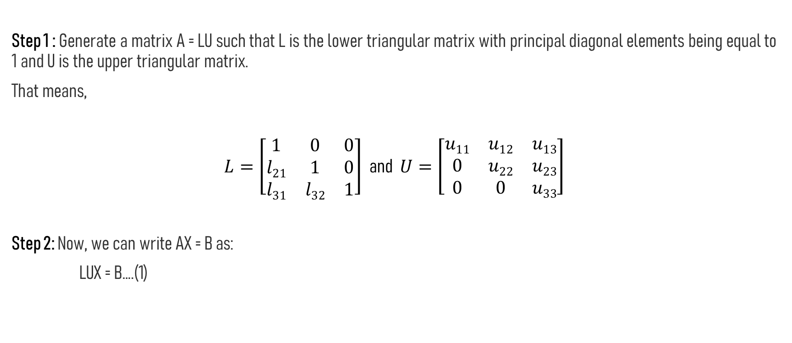
Steps for LU Decomposition
Step 1 : Generate a matrix A = LU such that L is the lower triangular matrix with principal diagonal elements being equal to 1 and U is the upper triangular matrix.
That means,
$L=\left[\begin{matrix}1 & 0 & 0 \\ l21 & 1 & 0 \\ l31 & l32 & 1\end{matrix}\right]$ and $U=\left[\begin{matrix}u11 & u12 & u13 \\ 0 & u22 & u23 \\ 0 & 0 & u33\end{matrix}\right]$
Step 2: Now, we can write AX = B as:
LUX = B….(1)

Slide 3
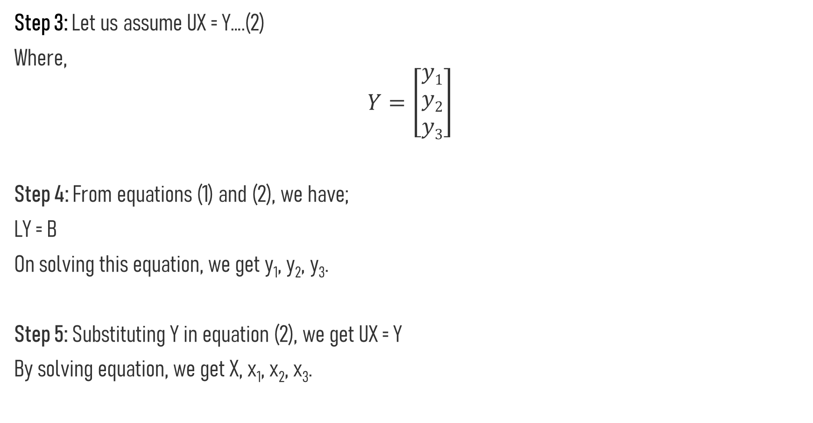
Step 3: Let us assume UX = Y….(2)
Where,
$$Y=\left[\begin{matrix}y1 \\ y2 \\ y3\end{matrix}\right]$$
Step 4: From equations (1) and (2), we have;
LY = B
On solving this equation, we get y₁, y₂, y₃.
Step 5: Substituting Y in equation (2), we get UX = Y
By solving equation, we get X, x₁, x₂, x₃.

Slide 4
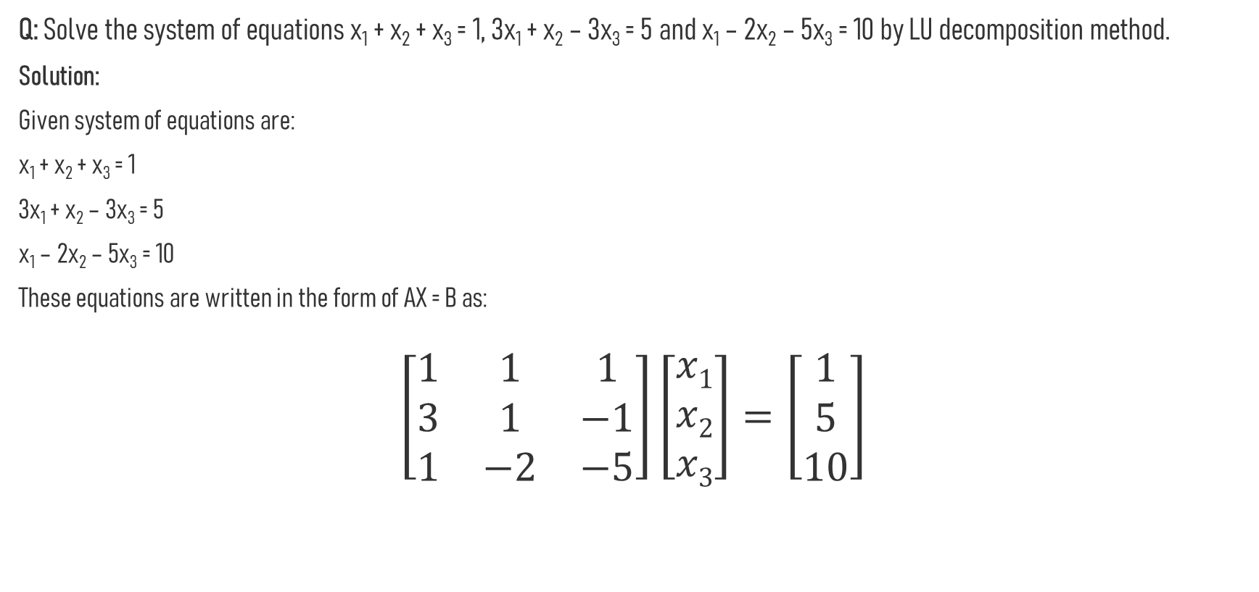
Example
Q: Solve the system of equations x₁ + x₂ + x₃ = 1, 3x₁ + x₂ – 3x₃ = 5 and x₁ – 2x₂ – 5x₃ = 10 by LU decomposition method.
Solution:
Given system of equations are:
x₁ + x₂ + x₃ = 1
3x₁ + x₂ – 3x₃ = 5
x₁ – 2x₂ – 5x₃ = 10
These equations are written in the form of AX = B as:
$$\left[\begin{matrix}1 & 1 & 1 \\ 3 & 1 & −1 \\ 1 & −2 & −5\end{matrix}\right]\left[\begin{matrix}x1 \\ x2 \\ x3\end{matrix}\right]=\left[\begin{matrix}1 \\ 5 \\ 10\end{matrix}\right]$$

Slide 5

Let us write the above matrix as LU = A.
That means,
$\left[\begin{matrix}1 & 0 & 0 \\ l21 & 1 & 0 \\ l31 & l32 & 1\end{matrix}\right] \left[\begin{matrix}u11 & u12 & u13 \\ 0 & u22 & u23 \\ 0 & 0 & u33\end{matrix}\right]$ = $\left[\begin{matrix}1 & 1 & 1 \\ 3 & 1 & −1 \\ 1 & −2 & −5\end{matrix}\right]$
By expanding the left side matrices, we get;
$$\left[\begin{matrix}u11 & u12 & u13 \\ l21u11 & l21u12+u22 & l21u13+u23 \\ l31u11 & l31u12+l32u22 & l31u13+l32u23+u33\end{matrix}\right]=\left[\begin{matrix}1 & 1 & 1 \\ 3 & 1 & −1 \\ 1 & −2 & −5\end{matrix}\right]$$

Slide 6
Thus, by equating the corresponding elements, we get;
u₁₁ = 1, u₁₂ = 1, u₁₃ = 1
l₂₁u₁₁ = 3,
l₂₁u₁₂ + u₂₂ = 1,
u₂₁u₁₃ + u₂₃ = -3
l₃₁u₁₁ = 1,
l₃₁u₁₂ + l₃₂u₂₂ = -2,
l₃₁u₁₃ + l₃₂u₂₃ + u₃₃ = -5
Solving these equations, we get;
u₂₂ = -2, u₂₃ = -6, u₃₃ = 3
l₂₁ = 3, l₃₁ = 1, l₃₂ = 3/2

Slide 7
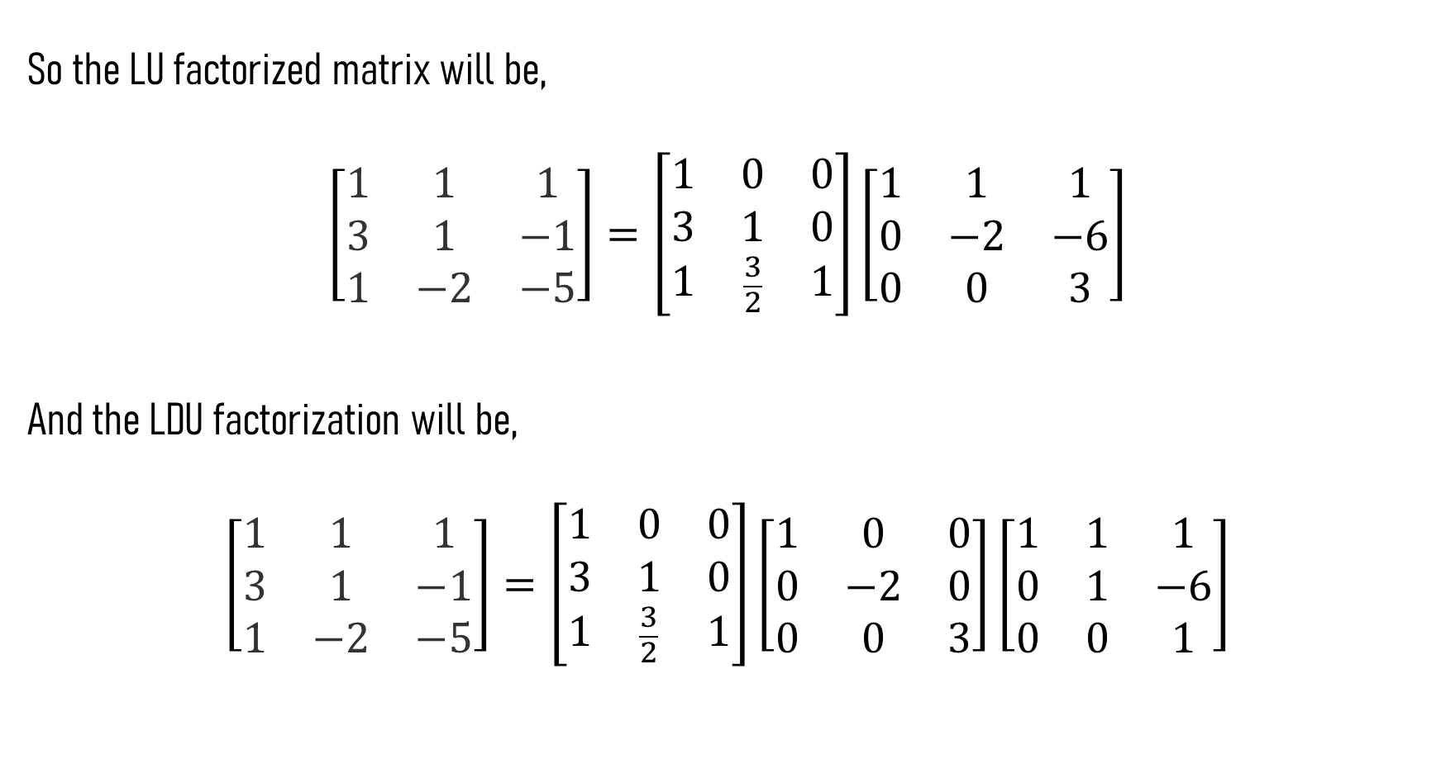
So the LU factorized matrix will be,
$$\left[\begin{matrix}1 & 1 & 1 \\ 3 & 1 & −1 \\ 1 & −2 & −5\end{matrix}\right]=\left[\begin{matrix}1 & 0 & 0 \\ 3 & 1 & 0 \\ 1 & \frac{3}{2} & 1\end{matrix}\right]\left[\begin{matrix}1 & 1 & 1 \\ 0 & −2 & −6 \\ 0 & 0 & 3\end{matrix}\right]$$
And the LDU factorization will be,
$$\left[\begin{matrix}1 & 1 & 1 \\ 3 & 1 & −1 \\ 1 & −2 & −5\end{matrix}\right]=\left[\begin{matrix}1 & 0 & 0 \\ 3 & 1 & 0 \\ 1 & \frac{3}{2} & 1\end{matrix}\right]\left[\begin{matrix}1 & 0 & 0 \\ 0 & −2 & 0 \\ 0 & 0 & 3\end{matrix}\right]\left[\begin{matrix}1 & 1 & 1 \\ 0 & 1 & −6 \\ 0 & 0 & 1\end{matrix}\right]$$

